Slide 1
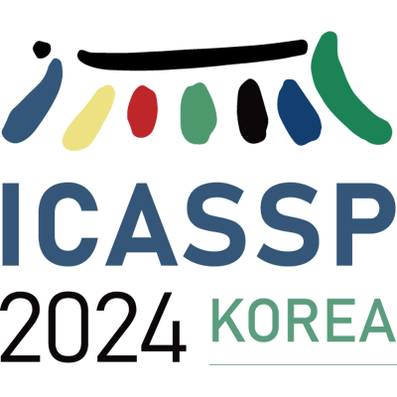







CONCSS: Contrastive-based Context Comprehension
for Dialogue-appropriate Prosody
in Conversational Speech Synthesis
Yayue Deng(邓雅月), Jinlong Xue, Yukang Jia, Qifei Li, Yichen Han, Fengping Wang, Yingming Gao, Dengfeng Ke, Ya Li
Beijing University of Posts and Telecommunications
Artificial Intelligence for Affective Interaction
Yayue Deng
Jinlong Xue
Yingming Gao
Dengfeng Ke
Ya Li

Slide 2
Outline
Why does dialogue context matter to speech synthesis?
What is Conversational Speech Synthesis (CSS)?
How to strengthen context understanding ?
Summary of contributions
Nishimura, Yuto, et al. "Acoustic modeling for end-to-end empathetic dialogue speech synthesis using linguistic and prosodic contexts of dialogue history." arXiv preprint arXiv:2206.08039 (2022).

Slide 3

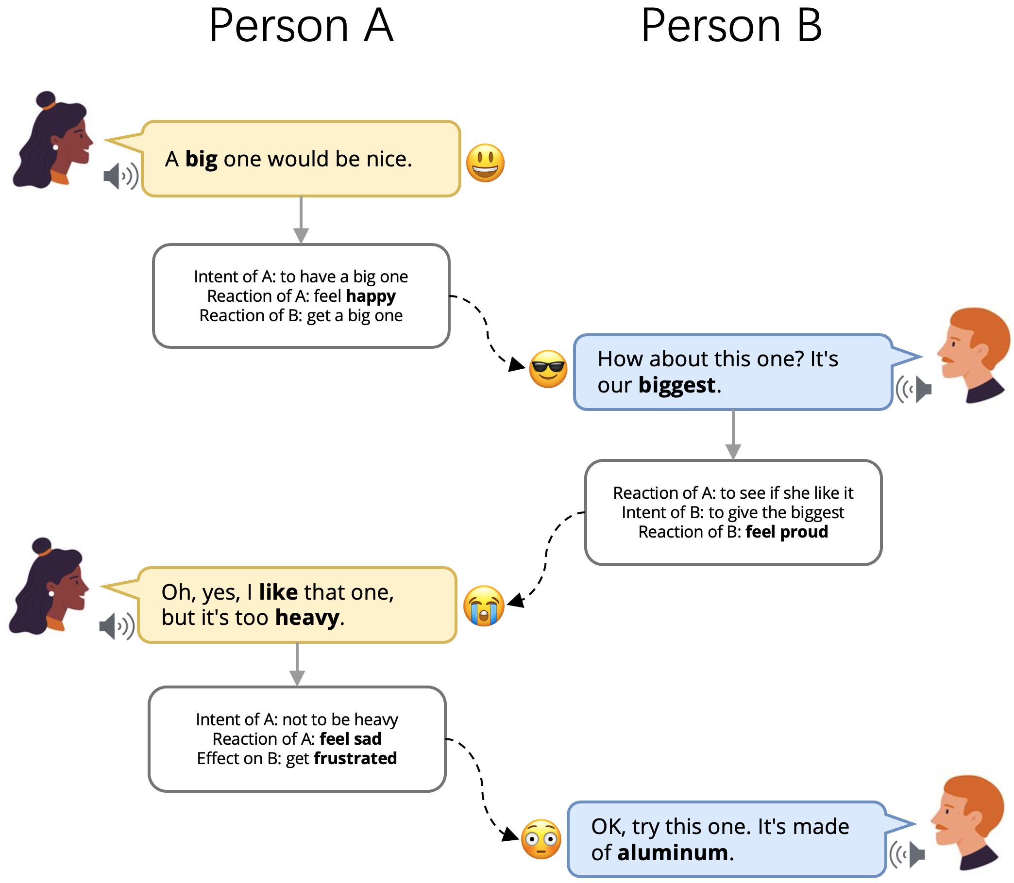
Background
Conversational Speech Synthesis, CSS
CSS Task Objective:
Focuses on improving the model’s context-understanding capability and generating audio with context-appropriate prosody.
How to understand speech?
“Semantic composition” : machine combines the meaning of words in a sentence as they are heard, so that they make sense in the context of what has already been said.
How dialogue context effect in speech synthesis?
Incorporating historical dialogues as supplementary information into speech synthesis can improve the model’s understanding of prior statements, thereby helping to enhance the prosody of the synthesized audio.
Context Understanding and Modeling
Speech Synthesis
Example inspired from “CMCU-CSS: Enhancing Naturalness via Commonsense-based Multi-modal Context Understanding in Conversational Speech Synthesis.” (Deng et al. 2023 ACM MM)

Slide 4
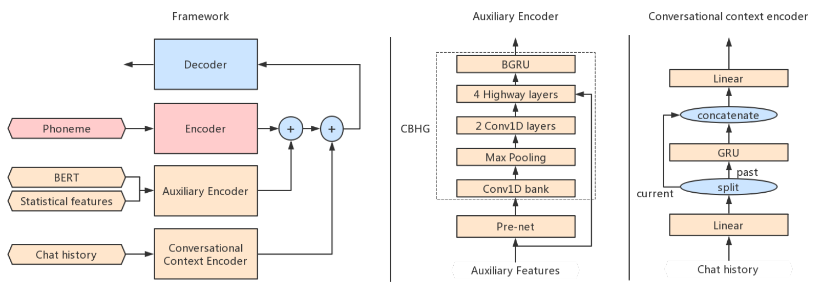
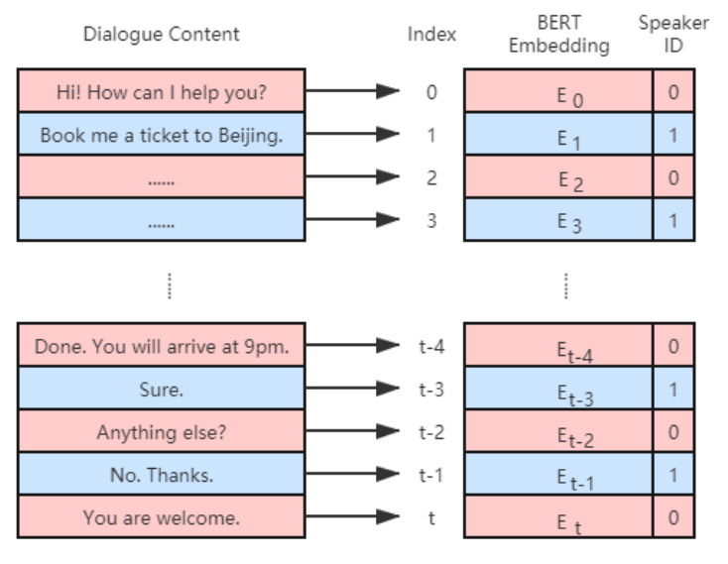
Related Work
Strengthen context understanding
Pretrained Language Model + A Conversational Context Encoder(CCE)
Context Understanding and Modeling
Speech Synthesis
Guo, Zhang, et al. “Conversational end-to-end TTS for voice agents,” in Proc. SLT, Shenzhen, China, Jan. 2021, pp. 403–409.

Slide 5
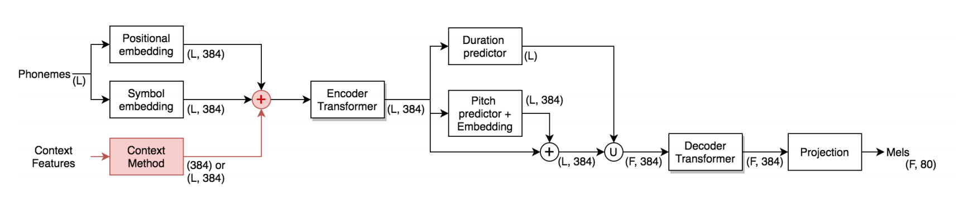
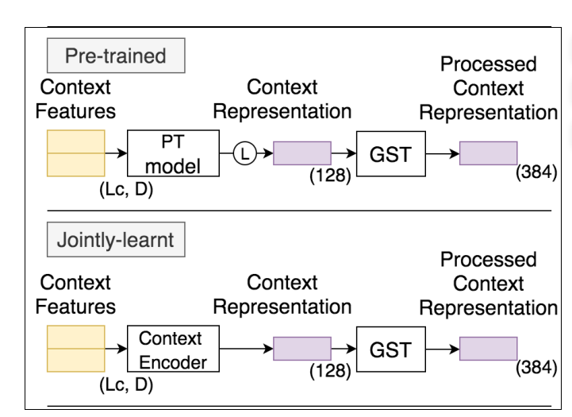
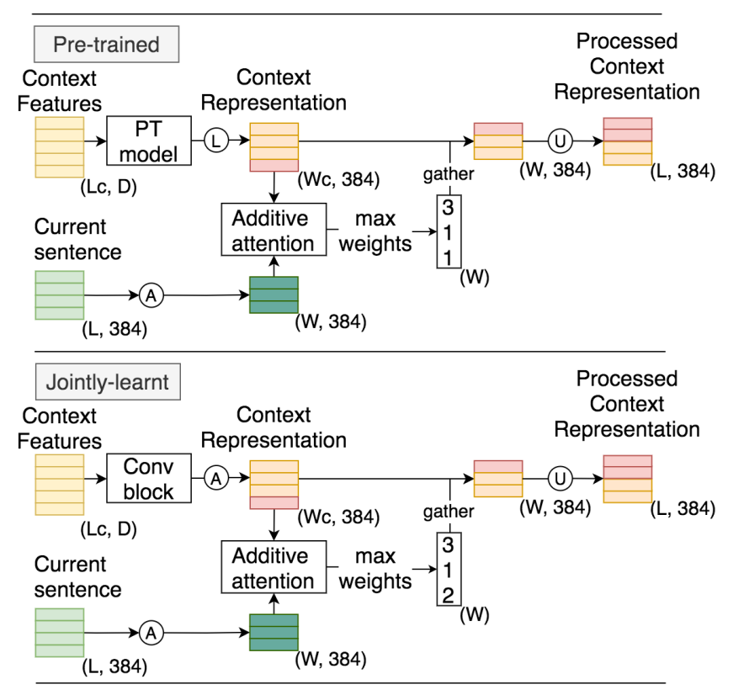
Related Work
Strengthen context understanding
Context Understanding and Modeling
Speech Synthesis
Context Method：
Acoustic VS. Textual Feature
Jointly-Learnt VS. Pre-trained condition
utterance-level VS. word-level
Pilar et al. “Comparing acoustic and textual representations of previous linguistic context for improving Text-to-Speech.” 11th ISCA Speech Synthesis Workshop (2021)

Slide 6
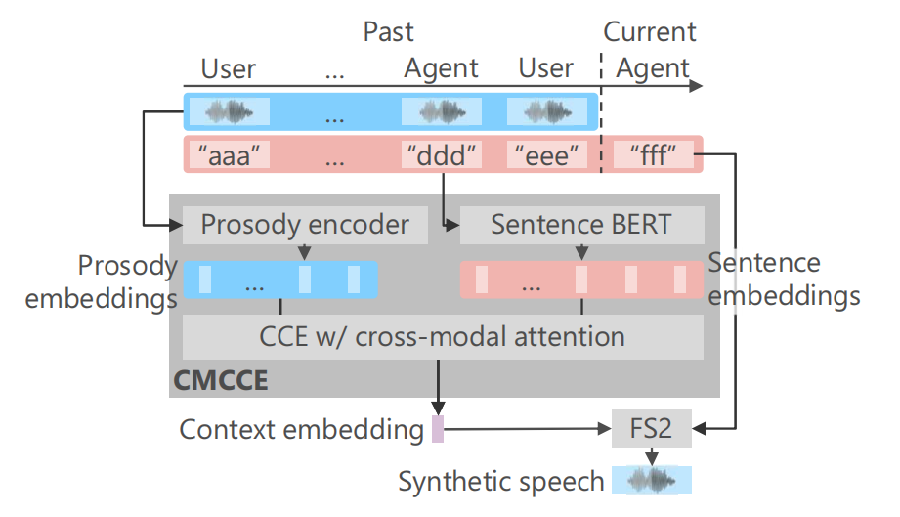
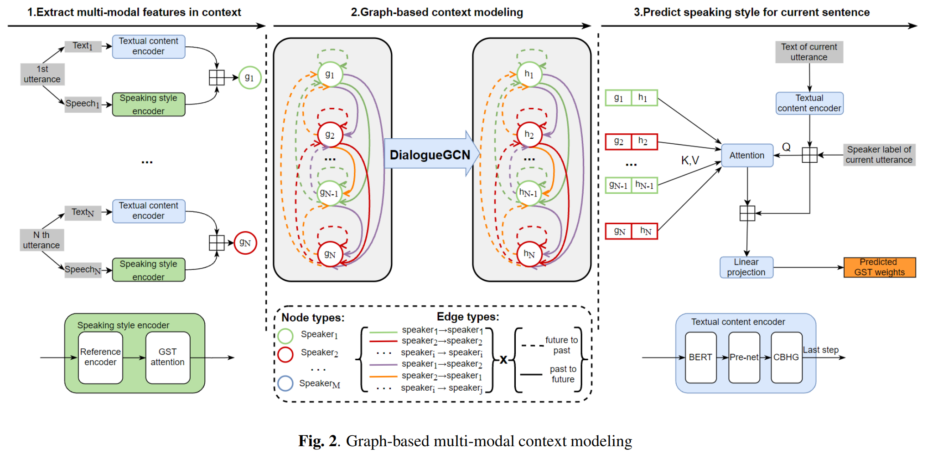
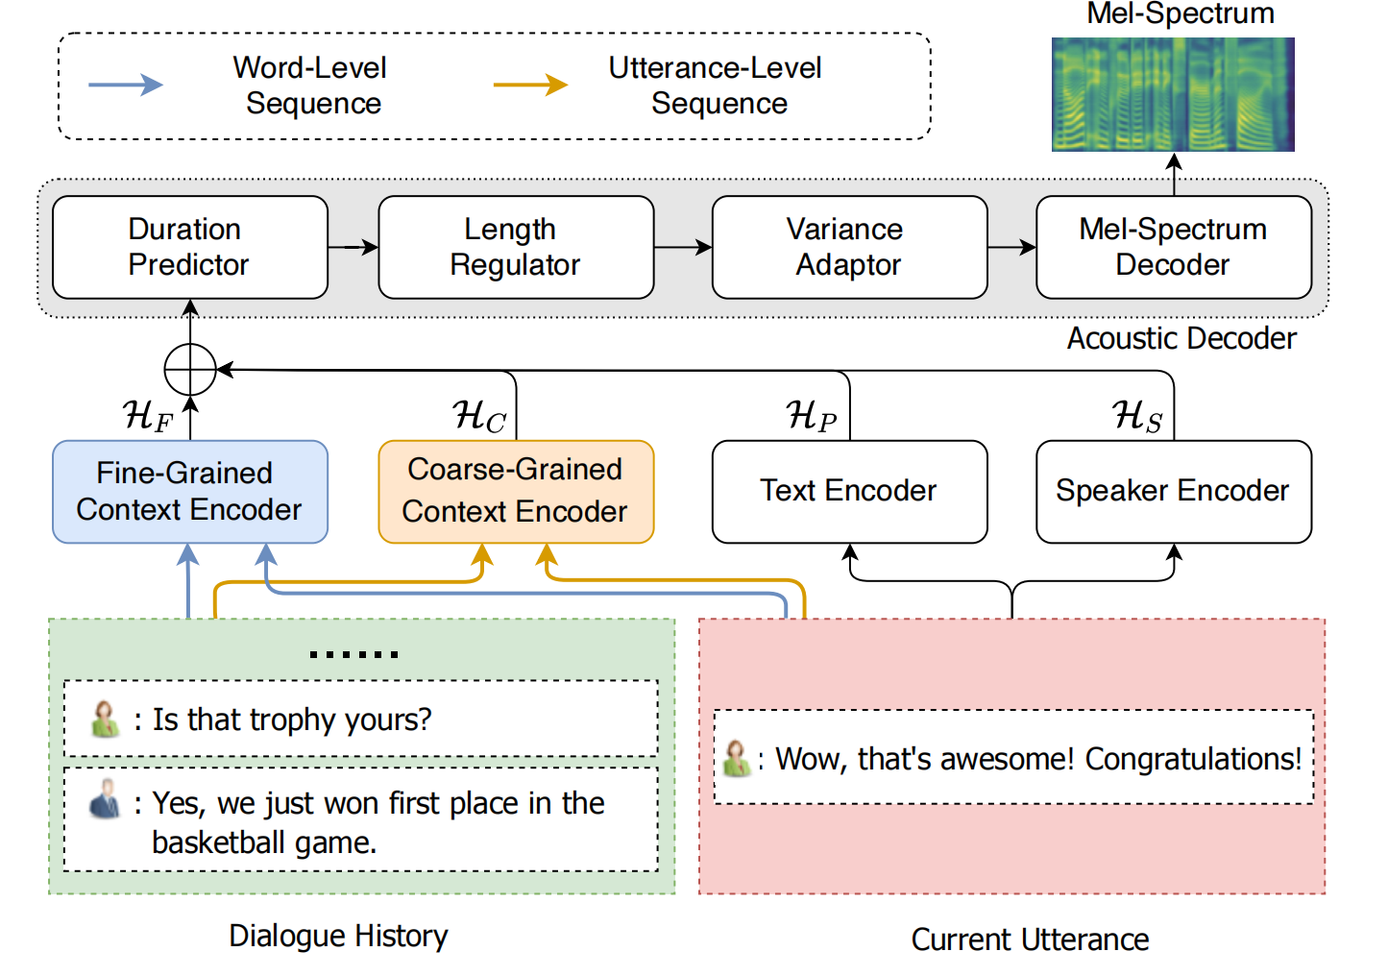
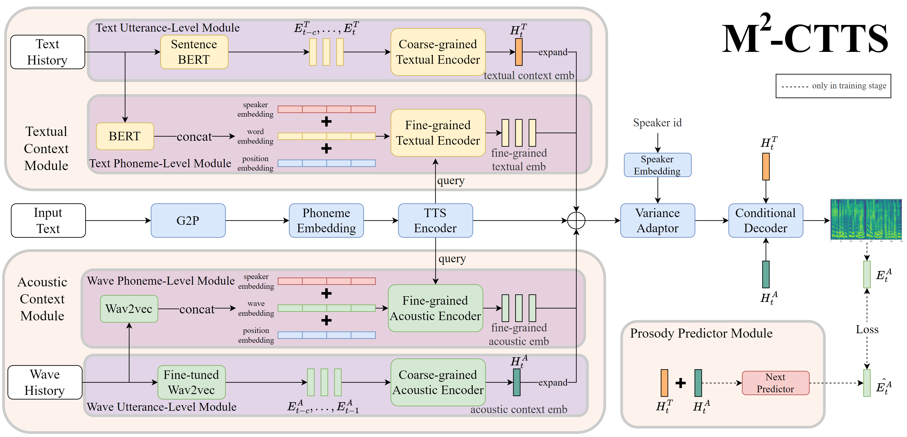
Related Work
Strengthen context understanding
Context Understanding and Modeling
Speech Synthesis
Adapt Graph or Cross-modal Attention
Use Fine-grained and Coarse-grained Context Information
Li, Meng, et al. “Enhancing Speaking Styles in Conversational Text-to-Speech Synthesis with Graph-based Multi-modal Context Modeling.” ICASSP 2022
Nishimura, Yuto, et al. "Acoustic modeling for end-to-end empathetic dialogue speech synthesis using linguistic and prosodic contexts of dialogue history." arXiv preprint arXiv:2206.08039.
Hu, Liu, et al. “FCTalker: Fine and Coarse Grained Context Modeling for Expressive Conversational Speech Synthesis.” arXiv preprint arXiv:2210.15360.
Xue, Deng, et al. “M2-CTTS: End-to-End Multi-Scale Multi-Modal Conversational Text-to-Speech Synthesis”. ICASSP 2023

Slide 7
Proposed Method
Limitation of Previous Works
These CSS approaches mostly rely on jointly training the acoustic model and context encoder using the mel-reconstruction loss.
Without explicit constraints, is this output vector of the context encoder sufficiently indicative of the underlying context variations?
Motivation
Output vector of the context encoder should be sensitive about the context
Context understanding module should be unsupervise trained because the dialogue tag is not easy to define and acquire

Slide 8
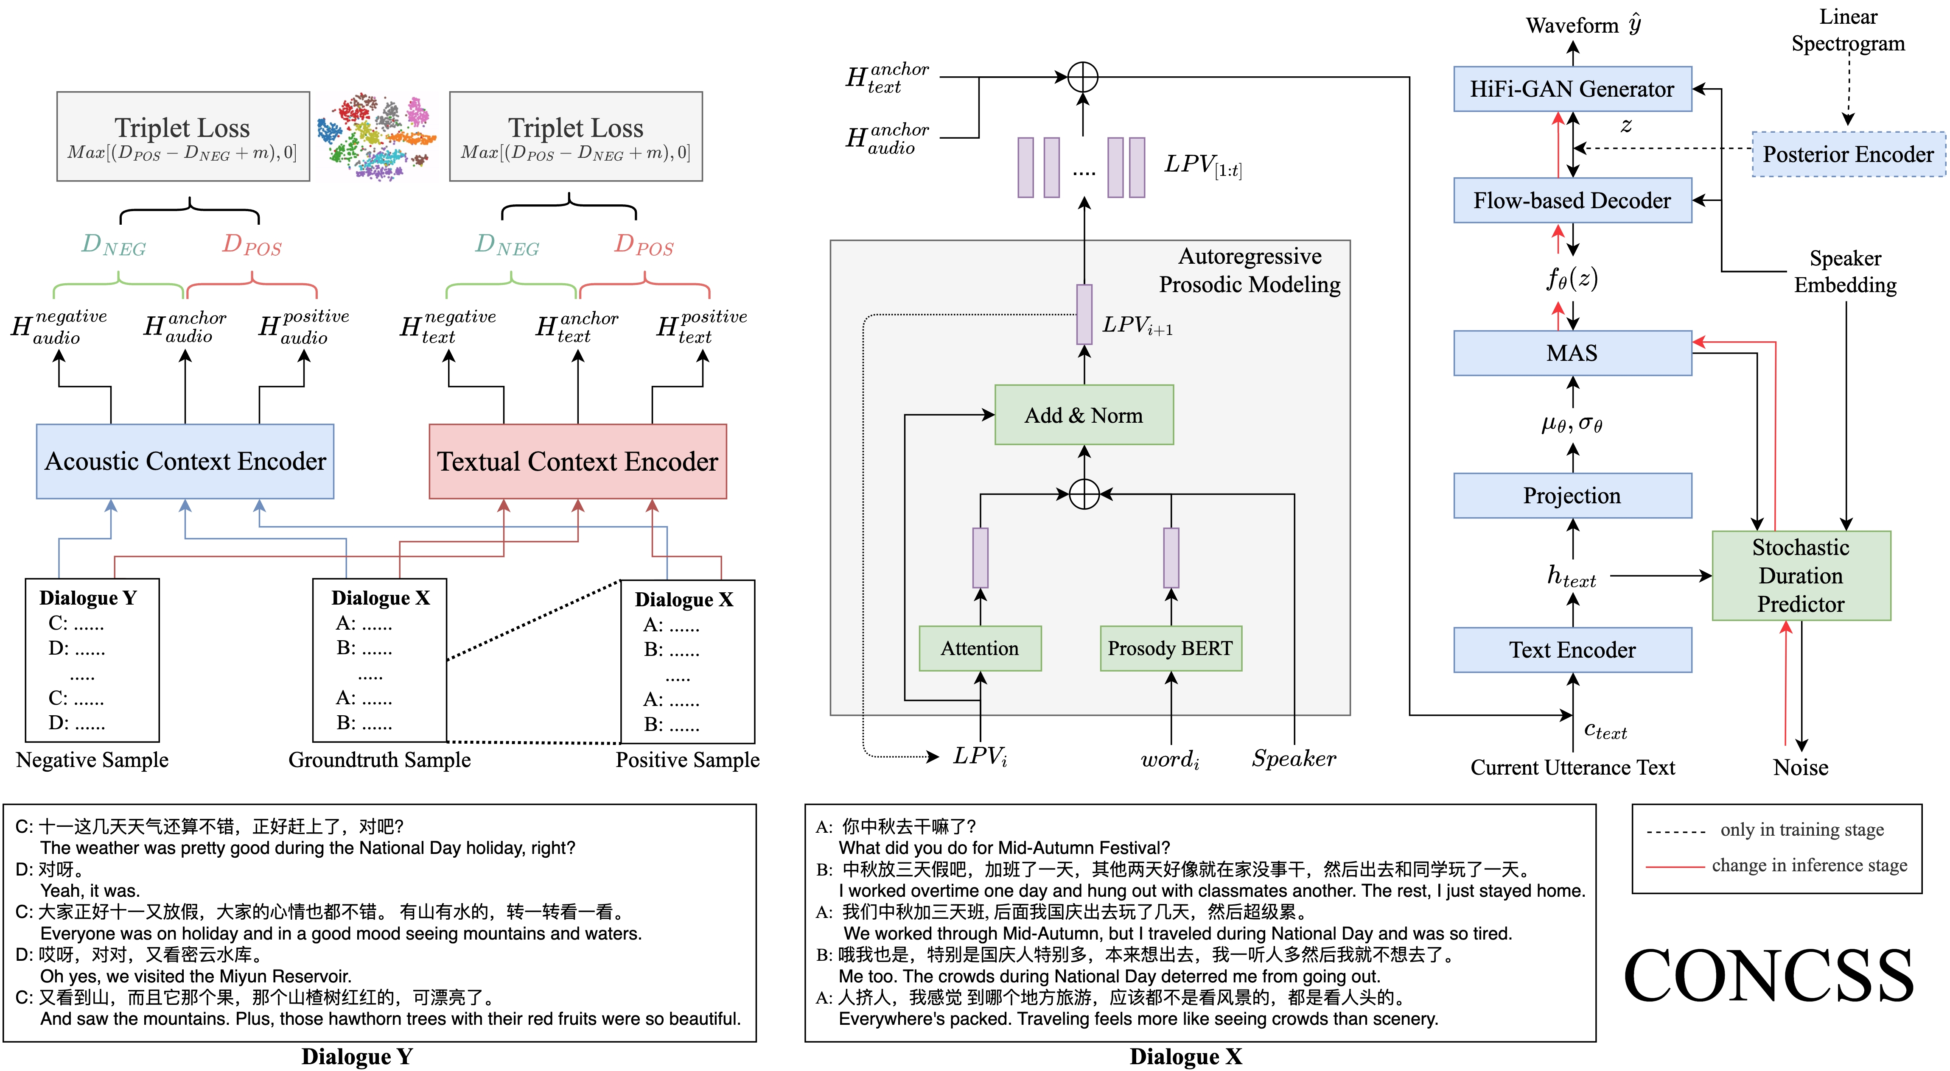
Proposed Method
Problem Definition and Framework Overview

Slide 9
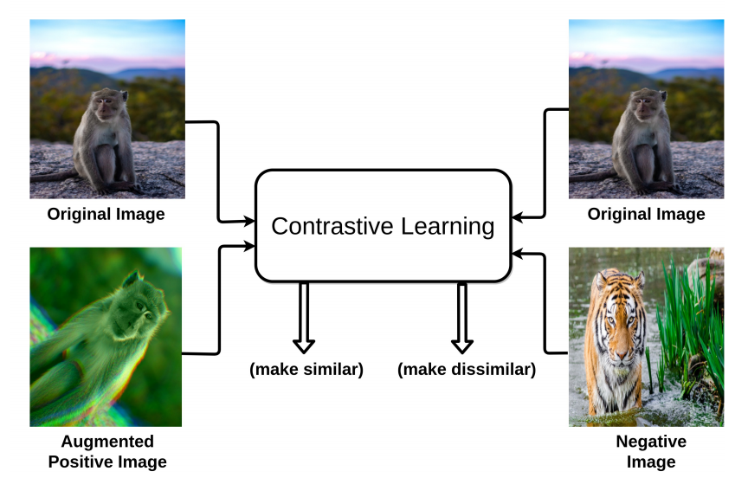
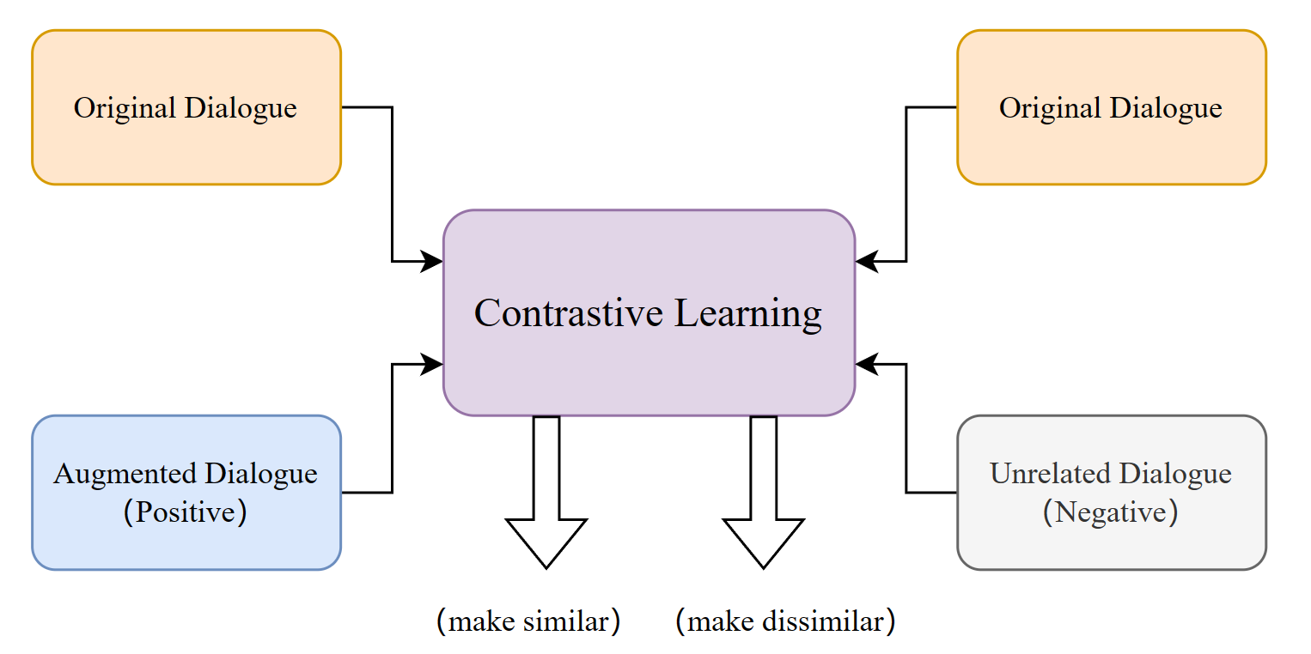
Proposed Method
We intergrate Contrastive learning into CSS framework to address the context understanding issue from a self-supervised perspective
Basic intuition behind contrastive learning paradigm:
push original and augmented images closer and push original and negative images away
Example inspired from “A Survey on Contrastive Self-Supervised Learning.” (Jaiswal et al. Technologies, 2020, 9(1): 2)

Slide 10
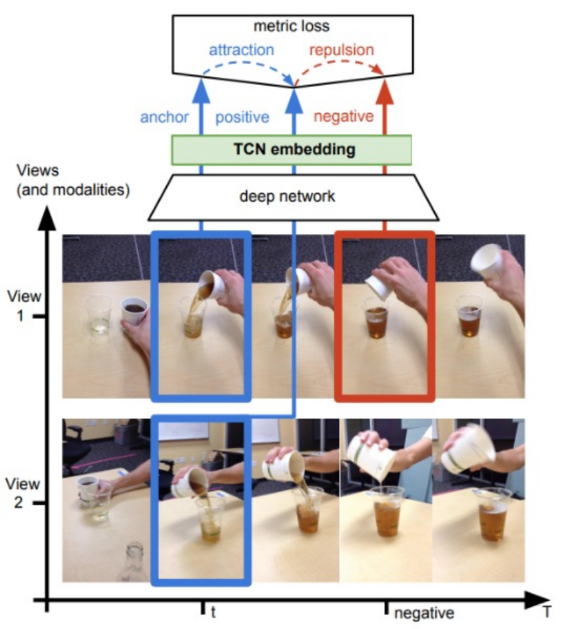
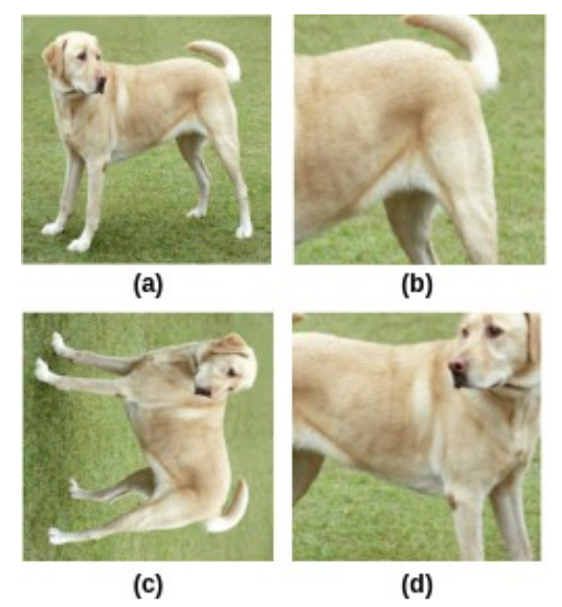
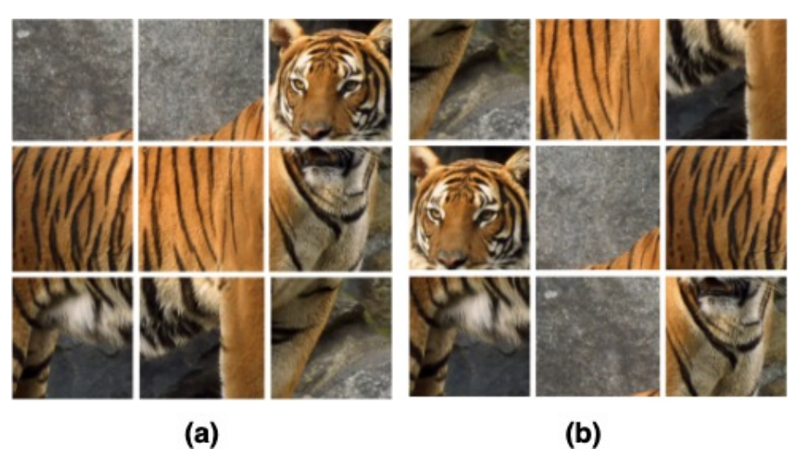
Proposed Method
Pretext tasks are self-supervised tasks that act as an important strategy to learn representations of the data using pseudolabels
We design a novel pretext task that forces the context encoder to generate distinct representations for diverse scenarios, thereby inducing context-related distinctiveness of prosody
Example inspired from “Self-Supervised Learning of Pretext-Invariant Representations.” (Misra et al. Proceedings of the IEEE/CVF conference on computer vision and pattern recognition. 2020)
Example inspired from “A Simple Framework for Contrastive Learning of Visual Representations.” (Chen, Kornblith, et al. arXiv 2020, arXiv:2002.05709)

Slide 11
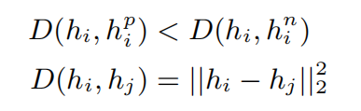
Proposed Method
Context-aware Contrastive Learning in proposed CONCSS framework
Pretext task Definition
Sampling Strategy : intra-speaker classes and inter-speaker classes

Slide 12
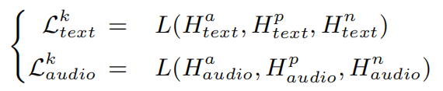
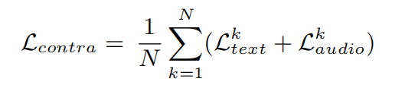
Proposed Method
Context-aware Contrastive Learning in proposed CONCSS framework
Multi-modal Context Comprehension with Triplet Loss
Autoregressive Prosodic Modeling

Slide 13
Experiments Setting
Dataset
Open-source Chinese conversational speech corpus from Magic Data
10 hours of transcribed Mandarin conversational speech, 30 speakers
Training
First pre-train VITS backbone on the Data Baker Chinese TTS dataset for an initial 5k steps
Then the whole CONCSS framework is trained on the Chinese conversation speech corpus for 20k steps
Prosody BERT is finetuned on the prosodic annotation of Data Baker Chinese TTS dataset to learn word-level prosody information
batch size 16, margin m 1, hop length 256, filter length 1024, sampling rate 16000, learning rate 2e-4,
Evaluation Metrics
Naturalness MOS, CMOS
Mel Loss, Log F0 RMSE, MCD

Slide 14
Evaluation
Compared Models
GRU-based : proposed by Guo et al. to achieve GRU-based context understanding.
M2CTTS : proposed by Xue et al. for multi-modal context understanding.
CONCSS-w/o-APM:
S1: adopts basic contrastive loss proposed by Chopra et al. Besides, it does not employ the sampling strategy
S2: utilizes triplet loss without using the hard negative sampling strategy.
S3: employs triplet loss and hard negative sampling strategy
CONCSS: The proposed CSS framework, denoted as S4

Slide 15
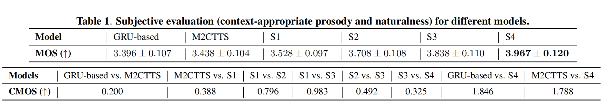
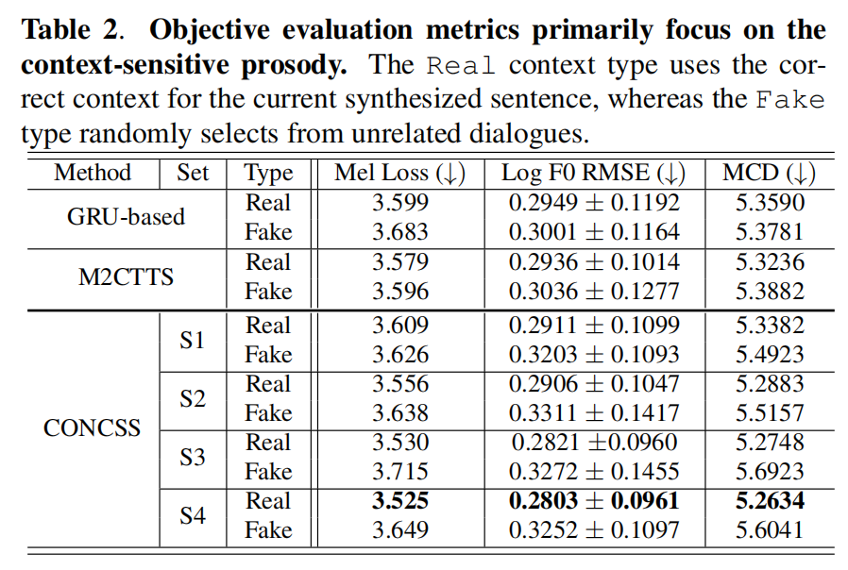
Evaluation
Comparison of Dialogue-Appropriate Prosody

Slide 16
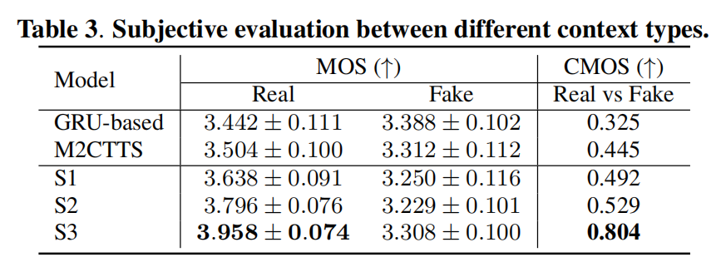

Evaluation
Comparison of Context-sensitive Distinctiveness
0.084
0.0191
0.185
0.4175

Slide 17
Conclusion
CONCSS, a contrastive learning-based CSS framework
Pretext Task
Sampling Strategy
Multi-modal Context Comprehension with Triplet Loss
Autoregressive Prosodic Modeling
Experience
Subjective evaluation
CSS task-specialized subjective evaluation method
Objective evaluation

Slide 18
Reference
[1] Jinlong Xue, Yayue Deng, Fengping Wang, Ya Li, Yingming Gao, Jianhua Tao, Jianqing Sun, and Jiaen Liang, “M2-ctts: End-to-end multi-scale multi-modal conversational text_x0002_to-speech synthesis,” in ICASSP 2023-2023 IEEE International Conference on Acoustics, Speech and Signal Processing (ICASSP). IEEE, 2023, pp. 1–5.
[2] Haohan Guo, Shaofei Zhang, Frank K Soong, Lei He, and Lei Xie, “Conversational end-to-end tts for voice agents,” in 2021 IEEE Spoken Language Technology Workshop (SLT). IEEE,2021, pp. 403–409.
[3] Jingbei Li, Yi Meng, Chenyi Li, Zhiyong Wu, Helen Meng, Chao Weng, and Dan Su, “Enhancing speaking styles in con_x0002_versational text-to-speech synthesis with graph-based multi_x0002_modal context modeling,” in ICASSP. 2022, pp.917–7921,IEEE.
[4] Jacob Devlin, Ming-Wei Chang, Kenton Lee, and Kristina Toutanova, “BERT: pre-training of deep bidirectional transformers for language understanding,” in NAACL-HLT (1). 2019, pp. 4171–4186, Association for Computational Linguistics.
[5] Yi Ren, Ming Lei, Zhiying Huang, Shiliang Zhang, Qian Chen, Zhijie Yan, and Zhou Zhao, “Prosospeech: Enhancing
prosody with quantized vector pre-training in text-to-speech,” in ICASSP. 2022, pp. 7577–7581, IEEE.
[6] Shun Lei, Yixuan Zhou, Liyang Chen, Jiankun Hu, Zhiyong Wu, Shiyin Kang, and Helen Meng, “Towards multiscale speaking style modelling with hierarchical context information for mandarin speech synthesis,”arXivpreprint arXiv:2204.02743, 2022.
[7] Vivek Kumar Rangarajan Sridhar, Ann K. Syrdal, Alistair Conkie, and Srinivas Bangalore, “Enriching text-to-speech synthesis using automatic dialog act tags,” inINTERSPEECH. 2011, pp. 317–320, ISCA.

Slide 19

Thanks for Listening
Presented by: YAYUE DENG（邓雅月）
yayue.deng@bupt.edu.cn

